Slide 1


























Outline
K記在G_input
新的sup記在graph_adj
刪掉edge前的圖放在graph_before
sup
$$4$$
14
13
$$5$$
7
$$4$$
$$4$$
$$5$$
$$4$$
$$4$$
5
15
16
$$3$$
3
$$5$$
$$7$$
$$5$$
$$7$$
8
$$4$$
12
$$7$$
6
$$4$$
1
$$6$$
4
$$5$$
$$2$$
$$8$$
11
$$5$$
$$6$$
0
2
10
$$3$$
$$5$$
$$7$$
9
$$3$$
$$6$$

Slide 2


























Outline
K記在G_input
新的sup記在graph_adj
刪掉edge前的圖放在graph_before
Upper k
$$6$$
14
13
$$7$$
7
$$6$$
$$6$$
$$7$$
$$6$$
$$6$$
5
15
16
$$4$$
3
$$6$$
$$8$$
$$7$$
$$8$$
8
$$6$$
12
$$7$$
6
$$6$$
1
$$7$$
4
$$7$$
$$4$$
$$9$$
11
$$6$$
$$7$$
0
2
10
$$4$$
$$6$$
$$8$$
9
$$5$$
$$7$$

Slide 3









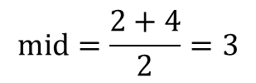
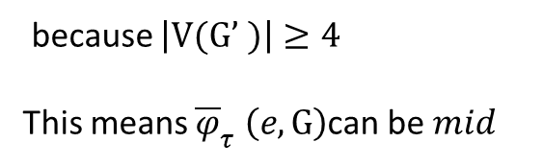


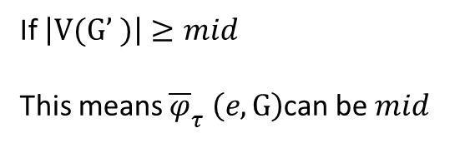



















Upper Bound
$$\sup_{2}\left(e,G\right)$$
${\overline{φ}}_{τ} (e,G)$: upper bound of $e(u,v)$
We found ${\overline{φ}}_{τ} \left(e,G\right)$ between $2 and \sup_{2}\left(e,G\right)+2$ by binary search
$G’:subgraph of \left\{u\right\}∪\left\{v\right\}∪\left\{∆_{τ}\left(e,G\right)\right\}with \sup_{2}\left(e,G\right)≥mid−2$
$$mid=\frac{2+4}{2}=3$$
$$2+2$$
$2$
$${\overline{φ}}_{τ} \left(e(1,2),G\right)=4$$
$$k$$
$$L$$
$${\overline{φ}}_{τ} \left(e(1,2),G\right)=3$$
$$R$$
$$L$$
$$5$$
8
$\left|V(G’ )\right|$={1,2,3,4}=4
$$mid$$
$$5$$
because $\left|V(G’ )\right|≥4$
This means ${\overline{φ}}_{τ} \left(e,G\right)$can be $mid$
If $\left|V(G’ )\right|≥mid$
This means ${\overline{φ}}_{τ} \left(e,G\right)$can be $mid$
6
$$3$$
4
$$5$$
$$7$$
$$5$$
$$7$$
9
12
$$7$$
7
2
$$6$$
5
$$5$$
$$2$$
$$2$$
$$8$$
$$6$$
1
3
11
$$3$$
$$5$$
$$7$$
10
$$6$$
Notes:
因為求$\sup_{2}\left(e,G\right)$ 是需要最大的上限，那這個上界是最大的不夠緊，所以使用二分搜尋找到更緊的bound
目的不是為了快速找到前幾名，而是避免上界都很大把太多點都考量進去!!

Slide 4



















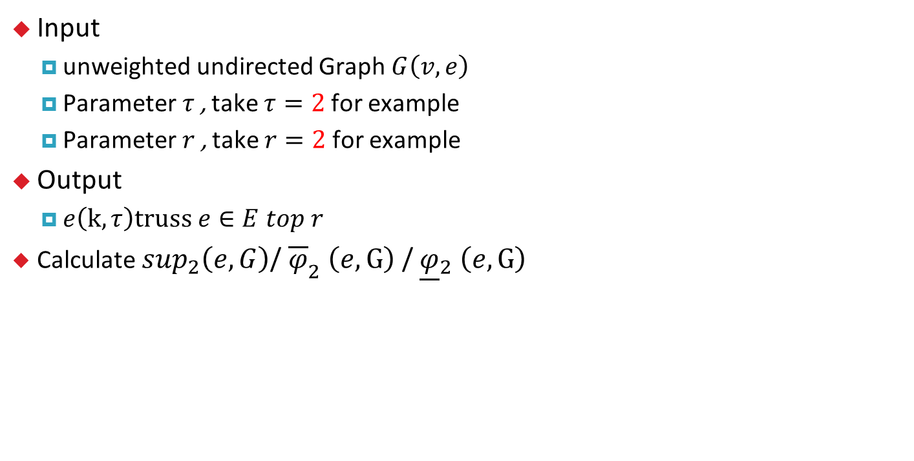
HOTTopR
$\sup_{2}\left(e,G\right)$/ ${\overline{φ}}_{2} \left(e,G\right)$/ ${\underline{φ}}_{2} \left(e,G\right)$
Input
unweighted undirected Graph $G\left(v,e\right)$
Parameter $τ$, take $τ=2$for example
Parameter $r$, take $r=2$for example
Output
$e\left(k,τ\right)truss e∈E top r$
Calculate $\sup_{2}\left(e,G\right)$/ ${\overline{φ}}_{2} \left(e,G\right)$/ ${\underline{φ}}_{2} \left(e,G\right)$
6
$$5/7/7$$
8
$$7/7/6$$
$$7/7/7$$
$$5/7/7$$
$$3/4/4$$
4
$$5/6/6$$
$$7/7/7$$
$$5/7/7$$
9
7
2
$$6/6/4$$
5
$$5/7/7$$
$$2/4/4$$
$$8/7/7$$
$$6/7/7$$
12
1
3
$$4/6/6$$
11
$$3/4/4$$
$$7/7/7$$
10
$$3/4/4$$
$$6/7/7$$

Slide 5

Higher-Order Truss Decomposition in Graphs
Z. Chen, L. Yuan, L. Han and Z. Qian,(2021)
IEEE Transactions on Knowledge and Data Engineering
, vol. 35, no. 4, pp. 3966-3978, 1 April 2023,
Cited: 11 (up to 2024/2/14)
https://ieeexplore.ieee.org/document/9662190
Advisor：Dr. Wei-Mei Chen
Student：Yu-Chia Chen

Slide 6
Outline
Introduction
Algorithm & Definition
Experiment
Conclusion

Slide 7
Introduction

Slide 8
Introduction
K-truss(2008)
Find modeling of multiple, overlapping community and dense-graph hierarchy
Application
Community detection
Community search
Graph mining…
https://docplayer.net/5372049-Trusses-cohesive-subgraphs-for-social-network-analysis.html

Slide 9
Introduction
Disadvantage
K-truss cannot analyze non-hierarchical community in normal graph
Goal
To analyze dense-graph in non-hierarchical community
Find Top r dense graph in non-hierarchical community
non hierarchical community

Slide 10
Algorithm & Definition

Slide 11
Algorithm
Original algorithm Pruning strategy Optimized algorithm
Delay update
High Order Truss
Decomposition
(HOTdecom)
Early pruning
HOTdecom+
Unchange support
The other optimized algorithm
High Order Truss
Top R
(HOTTopR)

Slide 12
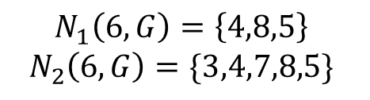
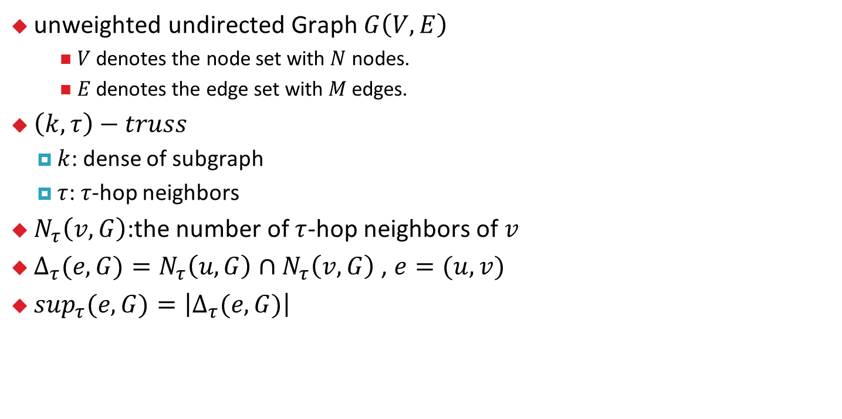
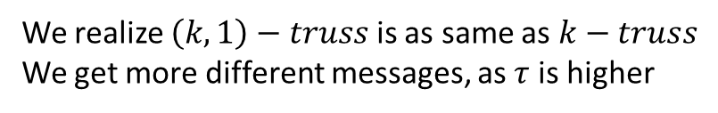
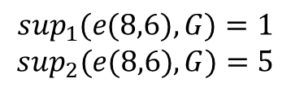
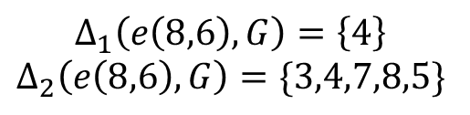
Definition
unweighted undirected Graph $G\left(V,E\right)$
$V$ denotes the node set with $N$ nodes.
$E$ denotes the edge set with $M$edges.
$\left(k,τ\right)−truss$
$k$: dense of subgraph
$τ$:$τ$-hop neighbors
$N_{τ}\left(v,G\right)$:the number of $τ$-hop neighbors of $v$
${∆_{τ}(e,G)=N}_{τ}\left(u,G\right)∩N_{τ}\left(v,G\right)$ , $e=(u,v)$
$\sup_{τ}(e,G)=\left|∆_{τ}(e,G)\right|$
3
4
7
8
6
5
$$N_{1}\left(6,G\right)=\left\{4,8,5\right\}$$
$$N_{2}\left(6,G\right)=\{3,4,7,8,5\}$$
$$∆_{1}\left(e\left(8,6\right),G\right)=\left\{4\right\}$$
$$∆_{2}\left(e\left(8,6\right),G\right)=\{3,4,7,8,5\}$$
$$\sup_{1}(e(8,6),G)=1$$
$$\sup_{2}(e(8,6),G)=5$$
We realize $\left(k,1\right)−truss$ is as same as $k−truss$
We get more different messages, as $τ$ is higher

Slide 13


K-truss
Input
unweighted undirected Graph $G\left(v,e\right)$
Parameter $τ$, take $τ=1$for example
Output
$e\left(k,τ\right)truss e∈E$
$$2−truss$$
$$3−truss$$

Slide 14

HOTdecom
Input
unweighted undirected Graph $G\left(v,e\right)$
Parameter $τ$, take $τ=2$for example
Output
$e\left(k,τ\right)truss e∈E$
Calculate $\sup_{2}\left(e,G\right)$
$$4$$
15
14
$$5$$
8
$$4$$
$$4$$
$$5$$
$$4$$
$$4$$
6
16
17
$$3$$
4
$$5$$
$$7$$
$$5$$
$$7$$
9
$$4$$
13
$$7$$
7
$$4$$
2
$$6$$
5
$$5$$
$$2$$
$$8$$
12
$$5$$
$$6$$
1
3
11
$$3$$
$$5$$
$$7$$
10
$$3$$
$$6$$

Slide 15



HOTdecom
$\left(k,2\right)truss$ start from $\min_{e∈E(G)}\sup_{2}\left(e,G\right)+2$
$φ_{τ}(e,G)$: maximum value of $k$ that $e$ is contained
$k→4$
Find $\sup_{2}\left(e,G\right)≤k−2$ to join the $\left(k,2\right)truss$
$φ_{τ}\left(e\left(1,2\right),G\right)=4$
$$4$$
15
14
$$5$$
8
$$4$$
$$4$$
$$5$$
$$4$$
$$4$$
6
16
17
$$3$$
4
$$5$$
$$7$$
$$5$$
$$7$$
9
$$4$$
13
$$7$$
7
$$4$$
2
$$6$$
5
$$5$$
$$2$$
$$8$$
12
$$5$$
$$6$$
1
3
11
$$3$$
$$5$$
$$7$$
10
$$3$$
$$6$$

Slide 16

HOTdecom
$\text{After} \text{deleting} e\left(1,2\right)\text{, }\text{there} \text{are}$
$$e^{′}=\left(u^{′},v^{′}\right)∈E\left(G\right), u^{′},v^{′}∈\{u\}∪\{v\}∪∆_{τ}(e,G)$$
$$\text{that} \text{they} \text{could} \text{be} \text{affected}\text{.}$$
$$4$$
15
14
$$5$$
8
$$4$$
$$4$$
$$5$$
$$4$$
$$4$$
6
16
17
$$3$$
4
$$5$$
$$7$$
$$5$$
$$7$$
9
$$4$$
13
$$7$$
7
$$4$$
2
$$6$$
5
$$5$$
$$8$$
$$6$$
12
$$5$$
1
3
11
$$3$$
$$5$$
$$7$$
10
$$3$$
$$6$$

Slide 17



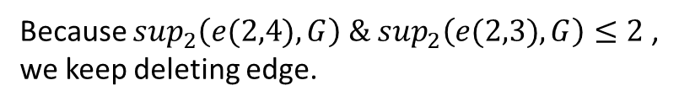

HOTdecom
$\text{After} \text{deleting} e\left(2,4\right)\text{, }\text{there} \text{are}$
$$e^{′}=\left(u^{′},v^{′}\right)∈E\left(G\right), u^{′},v^{′}∈\{u\}∪\{v\}∪∆_{τ}(e,G)$$
$$\text{that} \text{they} \text{could} \text{be} \text{affected}\text{.}$$
Because $\sup_{2}\left(e(2,4),G\right) \&\sup_{2}\left(e(2,3),G\right)≤2$ ,
we keep deleting edge.
$$4$$
15
14
$$5$$
8
$$4$$
$$4$$
$$5$$
$$4$$
$$4$$
6
16
17
$$2$$
4
$$5$$
$$7$$
$$5$$
$$7$$
9
$$4$$
13
$$7$$
7
$$4$$
2
$$5$$
5
$$5$$
$$8$$
$$6$$
12
$$5$$
1
3
11
$$2$$
$$5$$
$$7$$
10
$$3$$
$$6$$

Slide 18
HOTdecom
$\text{After} \text{deleting} e\left(2,4\right)\text{, }\text{there} \text{are}$
$$e^{′}=\left(u^{′},v^{′}\right)∈E\left(G\right), u^{′},v^{′}∈\{u\}∪\{v\}∪∆_{τ}(e,G)$$
$$\text{that} \text{they} \text{could} \text{be} \text{affected}\text{.}$$
Because $e\left(2,3\right)≤k−2$, we don’t recompute $\sup_{2}\left((2,3\right),G)$
$$4$$
15
14
$$5$$
8
$$4$$
$$4$$
$$5$$
$$4$$
$$4$$
6
16
17
4
$$5$$
$$7$$
$$5$$
$$7$$
9
$$4$$
13
$$7$$
7
$$4$$
2
$$5$$
5
$$5$$
$$8$$
$$6$$
12
$$5$$
1
3
11
$$2$$
$$5$$
$$7$$
10
$$3$$
$$6$$

Slide 19




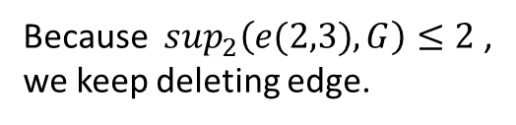
HOTdecom
$\text{After} \text{deleting} e\left(2,3\right)\text{, }\text{there} \text{are}$
$$e^{′}=\left(u^{′},v^{′}\right)∈E\left(G\right), u^{′},v^{′}∈\{u\}∪\{v\}∪∆_{τ}(e,G)$$
$$\text{that} \text{they} \text{could} \text{be} \text{affected}\text{.}$$
Because $\sup_{2}\left(e(2,3),G\right)≤2$ ,
we keep deleting edge.
$$4$$
15
14
$$5$$
8
$$4$$
$$4$$
$$5$$
$$4$$
$$4$$
6
16
17
4
$$4$$
$$7$$
$$5$$
$$7$$
9
$$4$$
13
$$7$$
7
$$4$$
2
$$4$$
5
$$5$$
$$8$$
$$6$$
12
$$5$$
1
3
11
$$2$$
$$4$$
$$7$$
10
$$3$$
$$6$$

Slide 20





HOTdecom
We find $\left(4,2\right)truss: \{\left(1,2\right),\left(2,4\right),(2,3)\}$ $\left(5,2\right)truss: \{\left(11,12\right)\}$
$k→6$
Start from $e(3,4)$
Red edge could be affected, so we need to recompute them.
But there are some edges may not be changed.
$$4$$
15
14
$$5$$
8
$$4$$
$$4$$
$$5$$
$$4$$
$$4$$
6
16
17
4
$$4$$
$$7$$
$$5$$
$$7$$
9
$$4$$
13
$$7$$
7
$$4$$
2
$$4$$
5
$$5$$
$$7$$
$$5$$
12
$$4$$
1
3
11
$$4$$
$$7$$
10
$$5$$

Slide 21
Algorithm
Original algorithm Pruning strategy Optimized algorithm
Delay update
High Order Truss
Decomposition
(HOTdecom)
Early pruning
HOTdecom+
Unchange support
The other optimized algorithm
High Order Truss
Top R
(HOTTopR)

Slide 22



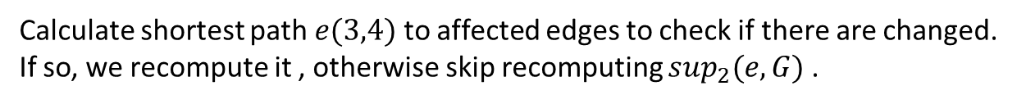
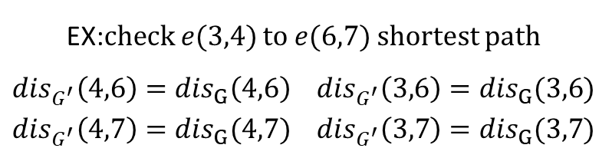















Unchange support
$k→5$
6
6
4
$$3$$
$$7$$
4
$$3$$
$$7$$
$$7$$
$$7$$
$$7$$
7
$$7$$
7
$$3$$
5
5
$$8$$
$$8$$
3
3
$$3$$
$$7$$
10
$$3$$
$$7$$
10
$$G$$
$$G′$$
Calculate shortest path $e(3,4)$ to affected edges to check if there are changed.
If so, we recompute it , otherwise skip recomputing $\sup_{2}(e,G)$ .
EX:$check e(3,4)$ to $e(6,7)$ shortest path
${dis}_{G^{′}}\left(4,6\right)={dis}_{G}\left(4,6\right)$ ${dis}_{G^{′}}\left(3,6\right)={dis}_{G}(3,6)$
${dis}_{G^{′}}\left(4,7\right)={dis}_{G}(4,7)$ ${dis}_{G^{′}}\left(3,7\right)={dis}_{G}(3,7)$

Slide 23
Unchange support
$k→5$
6
6
4
$$3$$
$$7$$
4
$$3$$
$$7$$
$$7$$
$$7$$
$$7$$
7
$$7$$
7
$$3$$
5
5
$$8$$
$$8$$
3
3
$$3$$
$$7$$
10
$$3$$
$$7$$
10
$$G$$
$$G′$$
We can find $e(6,7)$ and $e\left(7,10\right)$ that they are same distance between $G\&G′$

Slide 24



HOTdecom
$k→5$
We only recompute$\sup_{2}\left(e,G\right)$ that is not satisfied unchanged support.
$$4$$
15
14
$$5$$
8
$$4$$
$$4$$
$$5$$
$$4$$
$$4$$
6
16
17
4
$$3$$
$$7$$
$$5$$
$$7$$
9
$$4$$
13
$$7$$
7
$$4$$
2
5
$$5$$
$$7$$
$$6$$
12
$$5$$
1
3
11
$$3$$
$$7$$
10
$$6$$

Slide 25



HOTdecom
$k→5$
Keep deleting $\sup_{2}\left(e,G\right)≤3$ until none of them
$\left(5,2\right)truss: \{\left(3,4\right),\left(4,5\right),(3,5)\}$
$$4$$
15
14
$$5$$
8
$$4$$
$$4$$
$$5$$
$$4$$
$$4$$
6
16
17
4
$$2$$
$$7$$
$$5$$
$$7$$
9
$$4$$
13
$$7$$
7
$$4$$
2
5
$$5$$
$$7$$
$$6$$
12
$$5$$
1
3
11
$$2$$
$$7$$
10
$$6$$

Slide 26



HOTdecom
Algorithm won’t stop until all of edges in $G$ are deleted.
$$\left(4,2\right)truss$$
$$\left(5,2\right)truss$$
$$\left(6,2\right)truss$$
$$\left(7,2\right)truss$$
15
14
8
6
16
17
4
9
13
7
2
5
12
1
3
11
10
$$2−truss$$
$$3−truss$$

Slide 27
Algorithm
Original algorithm Pruning strategy Optimized algorithm
Delay update
High Order Truss
Decomposition
(HOTdecom)
Early pruning
HOTdecom+
Unchange support
The other optimized algorithm
High Order Truss
Top R
(HOTTopR)

Slide 28


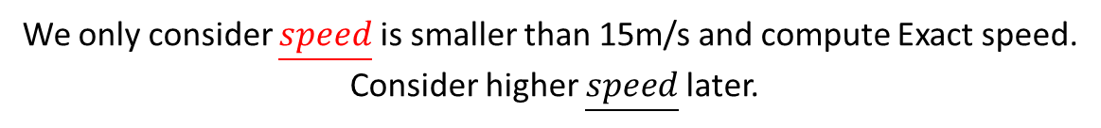

Delay update
Ideal is
Exact Speed: 20m/s 10m/s 5m/s 15m/s
$\underline{speed}$: 16m/s 8m/s 3m/s
We don’t know what Exact Speed is,
so we at least evaluate how fast they are in simple way.
We only consider $\underline{speed}$ is smaller than 15m/s and compute Exact speed.
Consider higher $\underline{speed}$later.

Slide 29
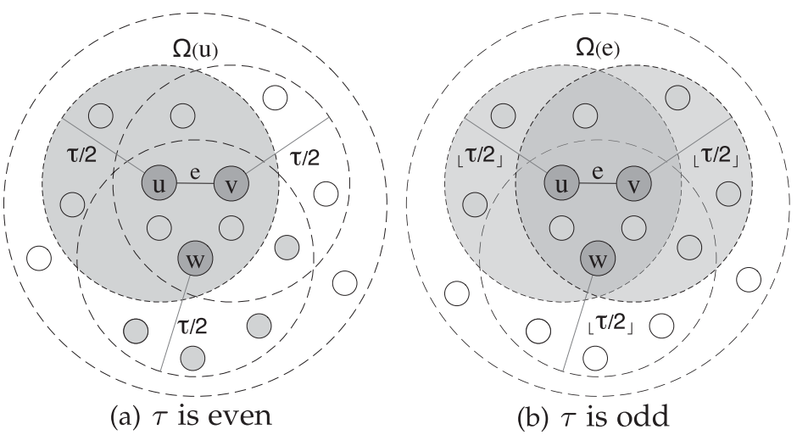
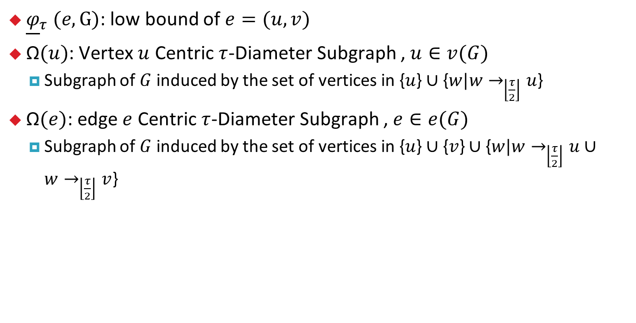
Delay update
${\underline{φ}}_{τ} (e,G)$: low bound of $e=(u,v)$
$\text{Ω}(u)$: Vertex$u$ Centric $τ$-Diameter Subgraph , $u∈v(G)$
Subgraph of $G$ induced by the set of vertices in {$u$} $∪$ {$w|w→_{\left\lfloor \frac{τ}{2}\right\rfloor }u$}
$\text{Ω}(e)$: edge$e$ Centric $τ$-Diameter Subgraph , $e∈e(G)$
Subgraph of $G$ induced by the set of vertices in {$u$} $∪$ {$v$} $∪$ {$w|w→_{\left\lfloor \frac{τ}{2}\right\rfloor }u∪w→_{\left\lfloor \frac{τ}{2}\right\rfloor }v$}
Notes:
目的:
1. 區別2和3所找的下界符合不同$τ$
2.減少計算下界時間

Slide 30
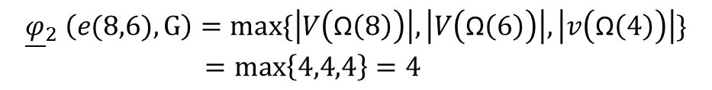

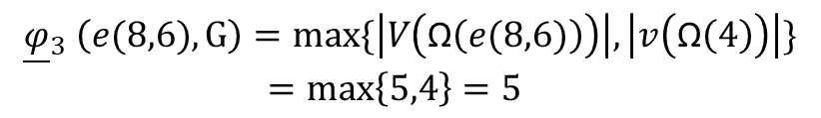
Delay update
${\underline{φ}}_{τ} (e,G)$: low bound of $e=(u,v)$
$τ is even:$
$\max\left\{\left|V\left(\text{Ω}\left(u\right)\right)\right|,\left|V\left(\text{Ω}\left(v\right)\right)\right|,\left|v\left(\text{Ω}\left(w\right)\right)\right|\right\}, w∈∆_{\left\lfloor \frac{τ}{2}\right\rfloor }(e,G)$
$τ is odd:$
$\max\left\{\left|V\left(\text{Ω}\left(e\right)\right)\right|, \left|v\left(\text{Ω}\left(w\right)\right)\right|\right\}, w∈∆_{\left\lfloor \frac{τ}{2}\right\rfloor }(e,G)$
3
4
7
8
6
5
$${\underline{φ}}_{3} \left(e(8,6),G\right)=max\{\left|V\left(\text{Ω}\left(e(8,6)\right)\right)\right|, \left|v\left(\text{Ω}\left(4\right)\right)\right|\}$$
$=max\left\{5,4\right\}=5$
$${\underline{φ}}_{2} \left(e(8,6),G\right)=max\{\left|V\left(\text{Ω}\left(8\right)\right)\right|,\left|V\left(\text{Ω}\left(6\right)\right)\right|,\left|v\left(\text{Ω}\left(4\right)\right)\right|\}$$
$=max\left\{4,4,4\right\}=4$

Slide 31
Algorithm
Original algorithm Pruning strategy Optimized algorithm
Delay update
High Order Truss
Decomposition
(HOTdecom)
Early pruning
HOTdecom+
Unchange support
The other optimized algorithm
High Order Truss
Top R
(HOTTopR)

Slide 32

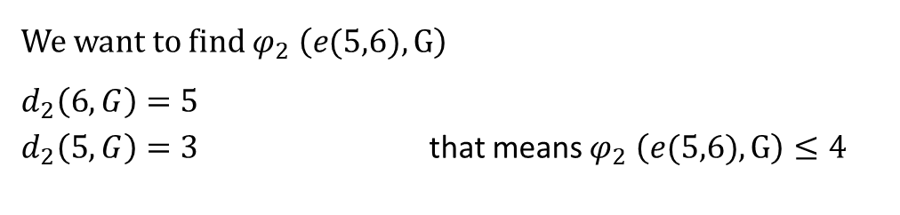
Early pruning
$d_{τ}(v,G)= \left|N_{τ}\left(v,G\right)\right|$
$d_{1}(6,G)=3$
$d_{2}(6,G)=5$
Lemma: $e=(u,v)∈V(G)$ if $d_{τ}\left(u,G\right)≤k−1∪d_{τ}\left(v,G\right)≤k−1$
$$φ_{τ} \left(e,G\right)≤k$$
We want to find $φ_{2} \left(e(5,6),G\right)$
$d_{2}\left(6,G\right)=5$
$d_{2}\left(5,G\right)=3$ that means $φ_{2} \left(e(5,6),G\right)≤4$
3
4
7
8
6
5
Notes:
目的:
用degree判別她可能的k-truss，如果<=k，砍掉他全部的edge(不是一條一條刪)

Slide 33

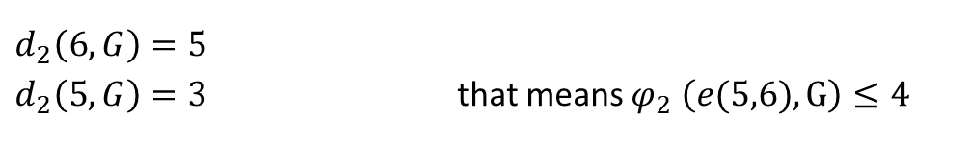
Early pruning
Because of $d_{2}\left(5,G\right)=3 \& k=4$, all of edge of $v5$ will be deleted
After deleting vertices, we also consider $N_{1}\left(5,G\right)=\left\{v6\right\}$ to check $v6$ is $d_{2}\left(6,G\right)≤k−1$ or not.
$d_{2}\left(6,G\right)=5$
$d_{2}\left(5,G\right)=3$ that means $φ_{2} \left(e(5,6),G\right)≤4$
3
4
7
8
6
5
Notes:
目的:
1. 區別2和3所找的下界符合不同$τ$
2.減少計算下界時間

Slide 34
Algorithm
Original algorithm Pruning strategy Optimized algorithm
Delay update
High Order Truss
Decomposition
(HOTdecom)
Early pruning
HOTdecom+
Unchange support
The other optimized algorithm
High Order Truss
Top R
(HOTTopR)

Slide 35























HOTdecom+
$\sup_{2}\left(e,G\right)$ / ${\underline{φ}}_{2} \left(e,G\right)$
Calculate ${\underline{φ}}_{2} (e,G)$
Start from ${k→min\underline{ φ}}_{2} \left(e,G\right)$
Compute $\sup_{2}\left(e,G\right) of {\underline{φ}}_{2} \left(e,G\right)=4$
$$6$$
15
14
$$7$$
8
$$6$$
$$6$$
$$7$$
$$6$$
$$6$$
6
16
17
$$4$$
4
$$6$$
$$7$$
$$7$$
$$6$$
9
$$6$$
13
$$7$$
7
$$6$$
2
$$4$$
5
$$7$$
$$4$$
$$7$$
12
$$6$$
$$7$$
1
3
11
$$4$$
$$6$$
$$7$$
10
$$4$$
$$7$$

Slide 36



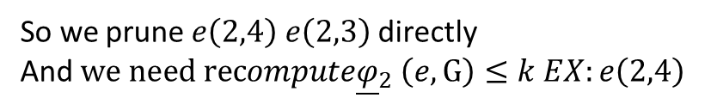




HOTdecom+
$\sup_{2}\left(e,G\right)$ / ${\underline{φ}}_{2} \left(e,G\right)$
We only consider whether red edge can be k=4 or not
Deleting edge starts from $\sup_{2}\left(e,G\right)≤k−2$ EX: $e(1,2)$
After deleting $e\left(1,2\right),$ $e\left(2,4\right)e\left(2,3\right)e\left(3,4\right)$could be affected
So we prune $e\left(2,4\right) e\left(2,3\right)$ directly
And $we need recompute{\underline{φ}}_{2} \left(e,G\right)≤k EX:e\left(2,4\right)$
Early pruning $d_{2}\left(2,G\right)=3≤k−1$ Yes
Delay update is there any affected edge ${\underline{φ}}_{2} \left(e,G\right)>k$ ? No
$$6$$
15
14
$$7$$
8
$$6$$
$$6$$
$$7$$
$$6$$
$$6$$
6
16
17
$$3/4$$
4
$$6$$
$$7$$
$$7$$
$$6$$
9
$$6$$
13
$$7$$
7
$$6$$
$$6/4$$
5
$$7$$
2
$$4/4$$
$$2/4$$
$$7$$
12
$$6$$
$$7$$
1
3
11
$$3/4$$
$$6$$
$$7$$
10
$$3/4$$
$$7$$
Notes:
Delay update 是指可能被影響的edge是否下界>k 有就不考慮

Slide 37







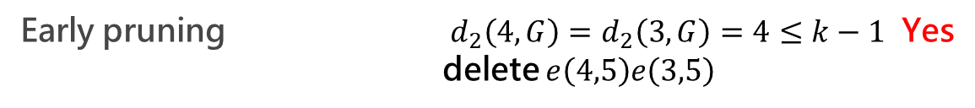








HOTdecom+
$\sup_{2}\left(e,G\right)$ / ${\underline{φ}}_{2} \left(e,G\right)$
$k→6$
Compute $\sup_{2}\left(e,G\right)$of red edge
All of red edge need to consider, we start from $e\left(3,4\right)$
After deleting $e\left(3,4\right)$, it might affect those red edges
Delay update is there any affected edge ${\underline{φ}}_{2} \left(e,G\right)>k$ ?
$e\left(6,7\right)e\left(5,7\right)e\left(7,10\right)e\left(5,10\right)$
Early pruning $d_{2}\left(4,G\right)=d_{2}\left(3,G\right)=4≤k−1$ Yes
delete $e\left(4,5\right)e\left(3,5\right)$
$\sup_{2}\left(e\left(5,6\right),G\right)>6−2$ skip
$$6$$
$$4/6$$
15
14
$$6$$
$$6$$
$$4/6$$
$$7$$
8
$$4/6$$
$$6$$
$$7$$
$$4/6$$
$$6$$
6
$$4/6$$
$$7$$
$$7$$
16
17
4
$$6$$
$$4/6$$
$$6$$
$$5/6$$
9
$$6$$
13
7
$$4/6$$
$$6$$
$$7$$
$$4/6$$
2
$$4/4$$
5
$$7$$
12
$$6$$
$$7$$
$$7$$
$$4/6$$
1
3
11
$$6$$
$$4/6$$
$$7$$
10
$$7$$
Notes:
k->5刪掉 e(11,12) delay update

Slide 38


HOTdecom+
$\sup_{2}\left(e,G\right)$ / ${\underline{φ}}_{2} \left(e,G\right)$
$k→7$
All of edge compute $\sup_{2}\left(e,G\right)$ and pruned by early pruning
Algorithm end
$$\left(4,2\right)truss$$
$$\left(5,2\right)truss$$
$$\left(6,2\right)truss$$
$$\left(7,2\right)truss$$
15
15
14
14
$$7$$
8
8
$$7$$
6
6
17
16
17
$$7$$
$$7$$
16
4
4
13
9
13
$$5/6$$
9
7
$$7$$
7
5
2
5
$$7$$
2
12
$$7$$
$$7$$
12
3
1
3
1
11
$$7$$
10
11
10
$$7$$

Slide 39
Algorithm
Original algorithm Pruning strategy Optimized algorithm
Delay update
High Order Truss
Decomposition
(HOTdecom)
Early pruning
HOTdecom+
Unchange support
The other optimized algorithm
High Order Truss
Top R
(HOTTopR)

Slide 40
Upper Bound
$$\sup_{2}\left(e,G\right)$$
${\overline{φ}}_{τ} (e,G)$: upper bound of $e(u,v)$
We found ${\overline{φ}}_{τ} \left(e,G\right)$ between $2 and \sup_{2}\left(e,G\right)+2$ by binary search
$G’:subgraph of \left\{u\right\}∪\left\{v\right\}∪\left\{∆_{τ}\left(e,G\right)\right\}with \sup_{2}\left(e,G\right)≥mid−2$
$$mid=\frac{2+4}{2}=3$$
$$2+2$$
$2$
$${\overline{φ}}_{τ} \left(e(1,2),G\right)=4$$
$$k$$
$$L$$
$${\overline{φ}}_{τ} \left(e(1,2),G\right)=3$$
$$R$$
$$L$$
$$5$$
8
$\left|V(G’ )\right|$={1,2,3,4}=4
$$mid$$
$$5$$
because $\left|V(G’ )\right|≥4$
This means ${\overline{φ}}_{τ} \left(e,G\right)$can be $mid$
If $\left|V(G’ )\right|≥mid$
This means ${\overline{φ}}_{τ} \left(e,G\right)$can be $mid$
6
$$3$$
4
$$5$$
$$7$$
$$5$$
$$7$$
9
12
$$7$$
7
2
$$6$$
5
$$5$$
$$2$$
$$2$$
$$8$$
$$6$$
1
3
11
$$3$$
$$5$$
$$7$$
10
$$6$$
Notes:
因為求$\sup_{2}\left(e,G\right)$ 是需要最大的上限，那這個上界是最大的不夠緊，所以使用二分搜尋找到更緊的bound
目的不是為了快速找到前幾名，而是避免上界都很大把太多點都考量進去!!

Slide 41
HOTTopR
$\sup_{2}\left(e,G\right)$/ ${\overline{φ}}_{2} \left(e,G\right)$/ ${\underline{φ}}_{2} \left(e,G\right)$
Input
unweighted undirected Graph $G\left(v,e\right)$
Parameter $τ$, take $τ=2$for example
Parameter $r$, take $r=2$for example
Output
$e\left(k,τ\right)truss e∈E top r$
Calculate $\sup_{2}\left(e,G\right)$/ ${\overline{φ}}_{2} \left(e,G\right)$/ ${\underline{φ}}_{2} \left(e,G\right)$
6
$$5/7/7$$
8
$$7/7/6$$
$$7/7/7$$
$$5/7/7$$
$$3/4/4$$
4
$$5/6/6$$
$$7/7/7$$
$$5/7/7$$
9
7
2
$$6/6/4$$
5
$$5/7/7$$
$$2/4/4$$
$$8/7/7$$
$$6/7/7$$
12
1
3
$$4/6/6$$
11
$$3/4/4$$
$$7/7/7$$
10
$$3/4/4$$
$$6/7/7$$

Slide 42

HOTTopR
$\sup_{2}\left(e,G\right)$/ ${\overline{φ}}_{2} \left(e,G\right)$/ ${\underline{φ}}_{2} \left(e,G\right)$
Start from $k_{max}→\max_{e∈E(G)}\left\{{\overline{φ}}_{2} \left(e,G\right)\right\} EX:7$
We only pick ${\overline{φ}}_{2} \left(e,G\right) >k_{max}−r$
Start computing this subgraph G by HOTdecom+
We will get top $r$ graph
8
6
4
$$5/7/7$$
9
6
7
8
5
$$7/7/7$$
$$5/7/7$$
$$7/7/6$$
$$3/4/4$$
4
$$5/6/6$$
$$7/7/7$$
$$5/7/7$$
9
3
7
11
2
$$6/6/4$$
5
10
$$5/7/7$$
$$2/4/4$$
$$8/7/7$$
$$6/7/7$$
12
1
3
$$4/6/6$$
11
$$3/4/4$$
$$7/7/7$$
10
$$3/4/4$$
$$6/7/7$$

Slide 43

Time complexity
Time complexity:
HOTdecom & HOTdecom+
$O(mm\left(m_{τ}+n_{τ}\right))$
HOTTopR
$O(r^{′}m^{′}m_{τ}\left(m_{τ}+n_{τ}\right)+mlogn_{τ}(m_{τ}+n_{τ}))$
$r^{′}$: the number of iterations
$m^{′}:$ the maximum number of edges of G

Slide 44
Experiment

Slide 45
Experiment
Comparing Algorithms
HOTD: HOTDecom algorithm.
HOTD+D: HOTDecom algorithm with the delayed update strategy.
HOTD+DU: HOTD+D algorithm with the unchanged support
HOTD+: HOTDecomþ algorithm
TOP-5: HOTTopR algorithm with r = 5
Environment
4 Intel Xeon 3.0GHz CPUs
64GB RAM
Linux
C++
All reported results were averaged over 5 repeated runs.
Notes:
COPRA :
-需要輸入最多可以overlapping 的數量 V
- first version of LPA that could detect overlapping communities
- consider importance between node and it’s neighbors , and propose a measurement called “belonging coefficient ”
- the “belonging coefficient” is compute by total label value divided degree of node
- propose a threshold V to consider delete or remain labels.
- if all labels are smaller than the threshold , then randomly choose one $⇒$ unstable !!!!
SLPA :
先定義好參數iterations T 以及 overlap 參數值V
- 記錄每一次的label情形
耗時 消耗空間
- at every iteration it’s will consider the history labels , then decide a dominate label from those labels
- more the #iterations higher the accuracy
- after converge or hit the maximum #iteration , compute the probability of the node’s belonging label
- at the end , propose a threshold to decide the labels of each node will delete or remain
- the threshold could control the algo become overlapping or non-overlapping
WCF-LPA(non-overlapping)
計算similarity 和core point，找出Center of community有影響力，以傳輸訊息。
Similarity是使用node degree，先找degree最大的當core起始，考慮它鄰居的degree。
從core開始傳播 ，其他點計算鄰居的影響力以及community。
之後有adjustment調整node label。
LPANNI (overlapping)
計算node important(NI) 和 similarity衡量點的影響力。
NI是找degree和鄰居組成幾個三角形。
Similarity跟鄰居是否緊密，本篇抄LPANNI來的
NGLPA
RIIM
用degree量測自己的重要程度Self-node important(SNI)
客觀計算出我這點的重要程度global node importance(GNI)—normalize
i與j相關性，用MNN(triangle) 和GNI，找出綜合評估指標RI
利用RI找出關係最緊密的點，每個點都這麼做。
最後，相互緊密的會成為一群，自動分開。

Slide 46
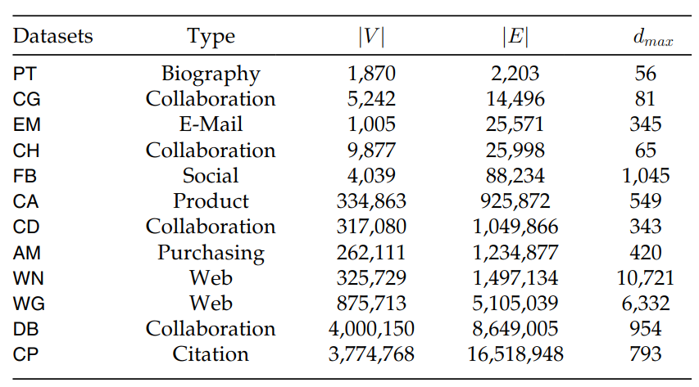
Experiment
Dataset

Slide 47
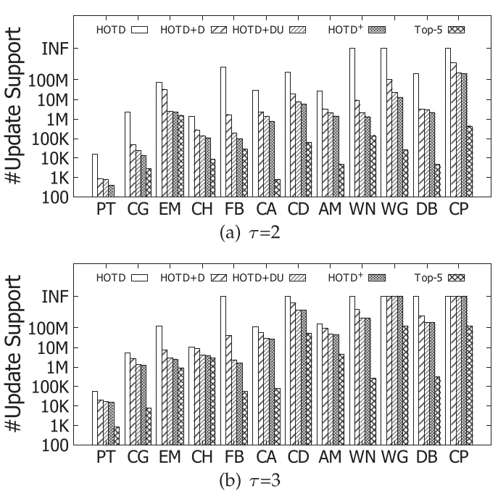
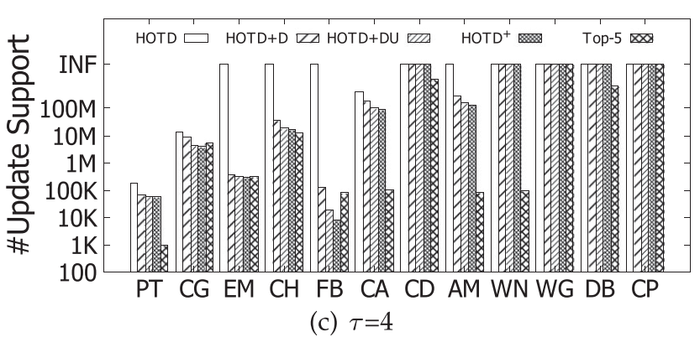
Experiment
INF: run out of 12 hours

Slide 48
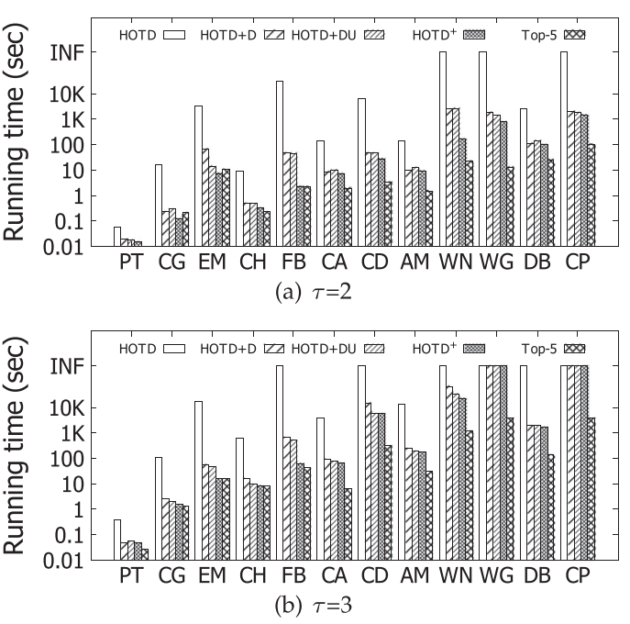
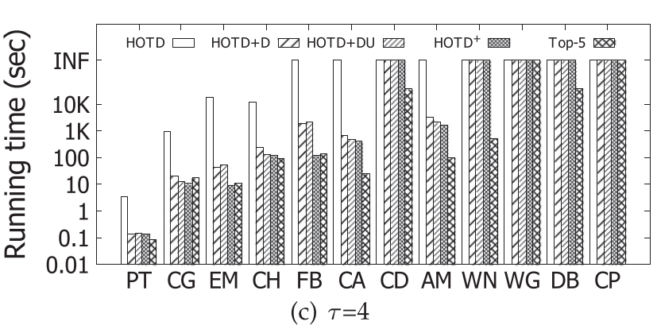
Experiment

Slide 49



Experiment
Define approximation error $AE$
Notes:
因為看更多鄰居，會得到更多訊息，下界再找時會失去更多訊息

Slide 50
Conclusion

Slide 51


Conclusion
Small graph or loosen graph is good
Too much compute time, not good for massive graph
Good
bad

Slide 52
Conclusion
Enumerating maximal clique may use k-truss to find it separately
Usually only find upper bound graph to find them in recent graph.
6
7
15
3
4
14
13
9
2
5
4
8
12
8
9
8
12
5
10
10
11

Slide 53
Thanks for listening

